Slide 1
THE INTERNATIONAL ARMED FORCES COUNCIL
This is also
Military Spouse
Appreciation Day.
INTERNATIONAL
ARMED FORCES NIGHT
IN COMMON
Advanced
Registration
Only
PURSUIT
SINCE 1960
61st
ANNUAL
EXTENDS AN INVITATION TO ACTIVE, RESERVE AND
RETIRED MILITARY OFFICERS, WARRANT OFFICERS and
GUESTS TO ATTEND THE 61st ANNUAL
INTERNATIONAL ARMED FORCES NIGHT DINING-OUT
FRIDAY 6 MAY 2022
Bar Opens: 1830 Hrs., Dinner 1930 Hrs.
American Polish Cultural Center
2975 E. Maple Road
Troy, Michigan 48083
Additional information
is available at web site:
www.IAFNC.org
HISTORY OF THE INTERNATIONAL ARMED FORCES NIGHT
The first International Armed Forces Night was organized in 1960 by officers of the 2451st AC&W Squadron RCAF (Aux) under Wing Commander Robert Norwood as a means to further solidify the excellent rapport which had been created with the US Military forces during the Squadron’s short history. The basic aim was to expand on the goals of the recently established International Freedom Festival. Upon demise of the 2451st in 1962, a way was explored by squadron members to continue these relationships with officers of the US Naval Air Station, Grosse Isle, and other US Training sites. An International Armed Forces Night was sponsored, first by the squadron members and the next year with US forces acting as hosts; thus the alternating leadership for this unique activity was developed. Beginning in 1965, all armed forces were included and the event was given its current name. In 1984, the 25th International Armed Forces Night drew a record number of officers from the military services of both countries. During the military down-sizing of the 1990’s, and especially with the inactivation of Michigan’s 70th Division in 1996, the event was much diminished. In 1999, however, in cooperation with the WW II 2nd Polish Corps Association, the event drew over 550 attendees. This very popular event, always the best party of the year, enables the officers of two great nations and many allied representatives, to join in an activity, completely unique in our knowledge, which promotes the friendly relations of their countries, and the professional cooperation of their military units.

Slide 2
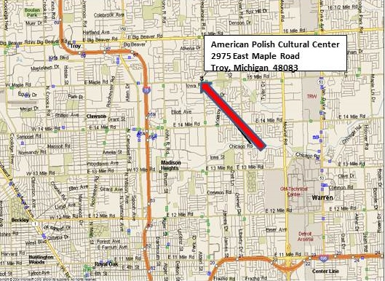
Music Will Be Provided By:
338th Army Band
US Army Reserve
Commander
CW3 Teresa Hudson
Dancing after Dinner
Music Provided By
338th Army Dance Band
Preferred uniform for the event is military mess dress or black tie, though class A uniform
or conservative civilian attire is welcome. Please see our Website (www.IAFNC.ORG) for more details.
COLOR GUARD
CANADIAN REGIMENTAL MARCHES SONGS OF THE U.S. SERVICES
OPEN BAR
DINNER WITH WINE SERVICE
CEREMONIAL TOASTS
THE INTERNATIONAL ARMED FORCES ACHIEVEMENT AWARD
TO MINIMIZE COSTS, THERE WILL BE NO TICKETS. YOU WILL BE CHECKED-IN ON A ROSTER AT THE DOOR. TO RESERVE YOUR SEATS, AND ENSURE YOUR CONTACT INFORMATION IS CORRECT, PLEASE FILL IN THE FOLLOWING INFORMATION. MAKE YOUR CHECK PAYABLE TO INTERNATIONAL ARMED FORCES COUNCIL, AND MAIL THIS PORTION OF OUR MAILER BACK TO:
Advanced Registration Only
In the United States: In Canada:
LTC Mario Musotto LCol Jim McGhie Capt Alison Amos
14448 Victoria Drive 123 Marentette 1225 Gladwin Blvd.
Sterling Heights, MI 48313 Belle River, ON CA N0R1A0 LaSalle, ON CA N9J 0A1
Telephone: 586-580-2091 Telephone: 519-979-8904 Telephone 519-978-3043
E-mail: marrose3@comcast.net E-Mail: Jim.McGhie@hotmail.com E-Mail: amos@mnsi.net
+++++++++++++++++++++++++++++++++++++++++++++++++++++++++++++++++++++++++++++++++++++++
Reservations for ______people at the dinner at $70 US or $70 Canadian each for a total of $__________
I AM: Rank:_______, Name: ____________________________________ Service:___________________________
Address:________________________________________________________, E-Mail:______________________
My Guests are: Rank/title:_____, Name: __________________________, Service:___________________________
Address:________________________________________________________, E-Mail:________________________
Rank/title:______, Name: ______________________________________, Service:_________________________
Address:_________________________________________________________, E-Mail:_______________________

